Slide 1

WiFi-Sense
Contactless Human Presence Detection & Ambient Intelligence via Wi-Fi Electromagnetic Wave Fluctuations

Slide 2



Hardware & Transceiver Architecture
Sender ESP32 Node
Receiver-Manager Node
Programmed to transmit continuous packet streams across 64 Wi-Fi channels. Functions as an RF signal emitter, creating an active electromagnetic field across the physical room.
Receives transmitted packets across multi-channel spectra. Captures variations in received signal properties and streams raw metric data over the Serial port interface.

Slide 3

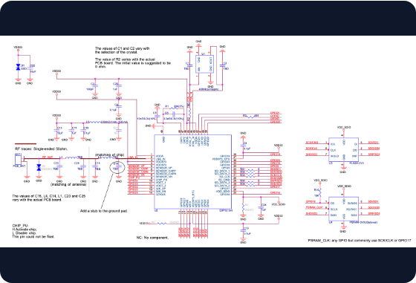
Data Acquisition Pipeline
Serial Data Stream: Python interface continuously reads high-frequency packet telemetry from the Receiver ESP32 via Serial connection.
Automated File Logger: Structured Python script parses incoming stream metrics and appends clean numerical logs into dataset files.
Wave Perturbation Analysis: Captures physical electromagnetic scattering and absorption caused by obstacles and movement.

Slide 4






Occupancy Data Labeling
Empty Room
1 Person Present
2 People Present
Baseline environment data with zero occupants. Represents natural background RF noise and static multipath baseline.
Single human occupant in the space. Introduces distinctive signal attenuation and localized phase variance pattern.
Multiple occupants in monitored area. Creates compound electromagnetic reflection and dynamic interference matrix.

Slide 5
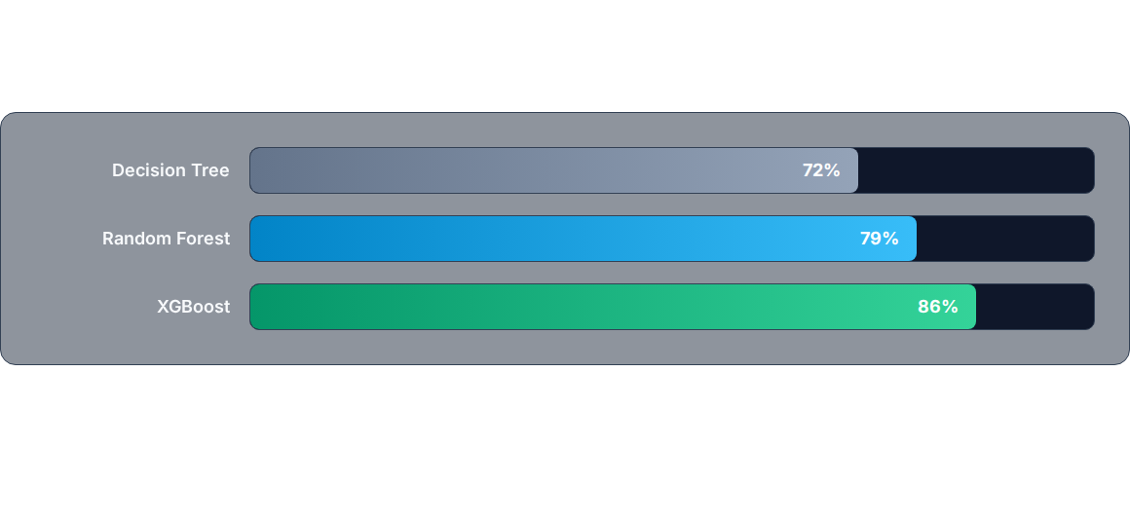
Machine Learning Performance
XGBoost achieved peak classification score by effectively capturing non-linear gradient dynamics across all 64 Wi-Fi channels.

Slide 6


Detection Accuracy
Reliable Camera-Free Sensing
By leveraging ensemble gradient boosting over multi-channel Wi-Fi signal power variance, WiFi-Sense accurately classifies room occupancy status with 86% accuracy without using any cameras, preserving complete user privacy.
Presence Accuracy

Slide 7

Streamlit Real-Time Dashboard
3-Second Sliding Window
The Streamlit web dashboard visualizes incoming signal power across channels using a 3-second rolling window for live dynamic analysis.
Real-time metric windows are continuously streamed into the trained XGBoost model, rendering immediate occupancy predictions on screen.

Slide 8



Vital Signs & Healthcare Vision
Heart Rate Sensing
Elderly & Patient Care
Automated Nurse Alarms
Enhancing wave resolution to capture micro-disturbances caused by chest wall displacement and cardiac pulse cycles.
Continuous non-invasive monitoring in hospitals and care facilities without requiring wearable body tags.
Triggering instantaneous emergency alerts to medical personnel if vital signs drop or critical anomalies occur.

Slide 9



Smart Building & Privacy Security
Building-Wide Scalability
3D Room Reconstruction
Scaling transceiver node range to span entire multi-room floors, creating a seamless, non-intrusive security network with zero privacy tradeoffs.
Utilizing high-precision multipath RF wave reflection mapping to reconstruct internal room geometry and simulate indoor spatial dynamics in 3D.

Slide 10
Questions & Discussion
Thank you for exploring the WiFi-Sense project.

Slide 11


Image Sources
https://docs.espressif.com/projects/esp-hardware-design-guidelines/en/latest/esp32/_images/esp32-sche-core.png
Source: docs.espressif.com
https://cdn.prod.website-files.com/617960145ff34f911afe7243/692610a2df06ad0ee562a700_Analytics%20Dashboards%20with%20Real-Time%20Financial%20Data%20.jpg
Source: intrinio.com

